Slide 1
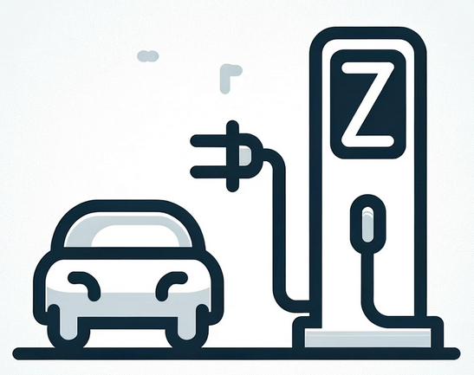






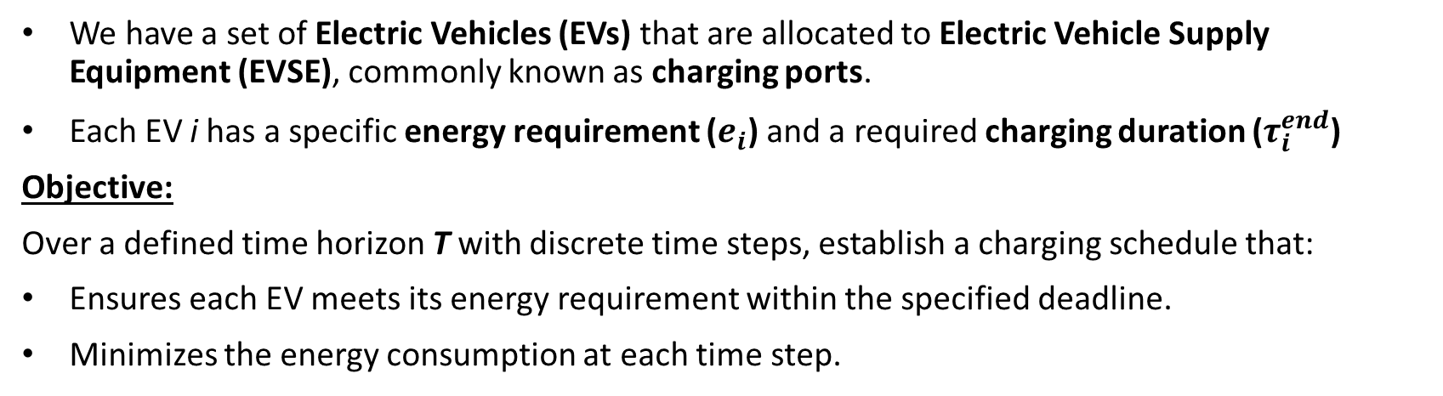









Problem Statement
We have a set of Electric Vehicles (EVs) that are allocated to Electric Vehicle Supply Equipment (EVSE), commonly known as charging ports.
Each EV i has a specific energy requirement ($e_{i}$) and a required charging duration ($τ_{i}^{end}$)
Objective:
Over a defined time horizon T with discrete time steps, establish a charging schedule that:
Ensures each EV meets its energy requirement within the specified deadline.
Minimizes the energy consumption at each time step.
$$t_{0}$$
$$t_{1}$$
$$t_{2}$$
$$t_{3}$$
$$t_{4}$$
$$t_{5}$$
$$t_{6}$$
$$t_{7}$$
$$T$$
$$e_{1}$$
$$τ_{1}^{end}$$
$$e_{2}$$
$$τ_{2}^{end}$$
$$e_{3}$$
$$τ_{3}^{end}$$

Slide 2
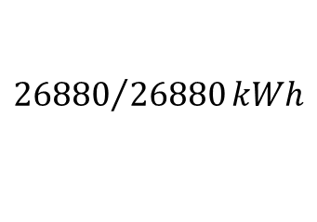

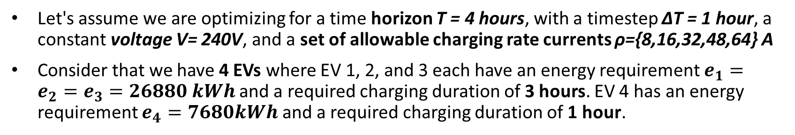

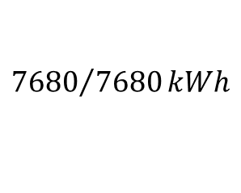

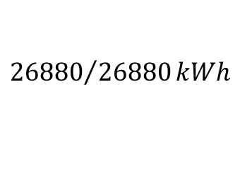

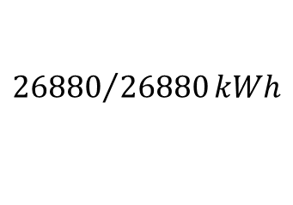
Toy Example
Let's assume we are optimizing for a time horizon T = 4 hours, with a timestep ΔT = 1 hour, a constant voltage V= 240V, and a set of allowable charging rate currents ρ={8,16,32,48,64} A
Consider that we have 4 EVs where EV 1, 2, and 3 each have an energy requirement $e_{1}=e_{2}=e_{3}=26880 kWh$and a required charging duration of 3 hours. EV 4 has an energy requirement $e_{4}=7680kWh$ and a required charging duration of 1 hour.
$$t_{0}$$
$$t_{1}$$
$$t_{2}$$
$$t_{3}$$
T
16 A | 48 A | 48 A | 0
32A | 48A | 32A | 0
32A | 32A | 48A | 0
32A | 0 | 0 | 0
$${26880}/{26880}kWh$$
$${26880}/{26880}kWh$$
$${26880}/{26880}kWh$$
$${7680}/{7680}kWh$$

Slide 3
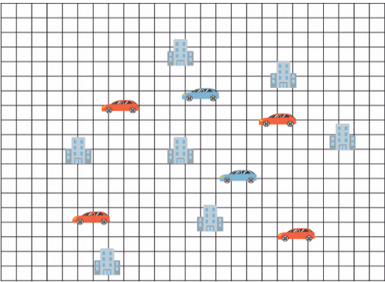
EV charging station placement problem
Aman Chandra, Jitesh Lalwani, Babita Jajodia: “Towards an Optimal Hybrid Algorithm for EV Charging Stations Placement using Quantum Annealing and Genetic Algorithms”
Buildings: Point of Interest (POI)
Blue Cars: Existing charging stations
Red Cars: New charging stations

Slide 4
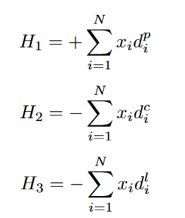
EV charging station placement problem
Aman Chandra, Jitesh Lalwani, Babita Jajodia: “Towards an Optimal Hybrid Algorithm for EV Charging Stations Placement using Quantum Annealing and Genetic Algorithms”
Objective:
Install the new chargers at the minimum possible distance from the point of interest.
Ensure that the chargers are placed at the maximum possible distance from the existing chargers and at the maximum distance from each other.
Solved: Quantum Annealing combined with Genetic Algorithm
Quantum Annealing
QA output
Genetic Algorithm
Solution

Slide 5
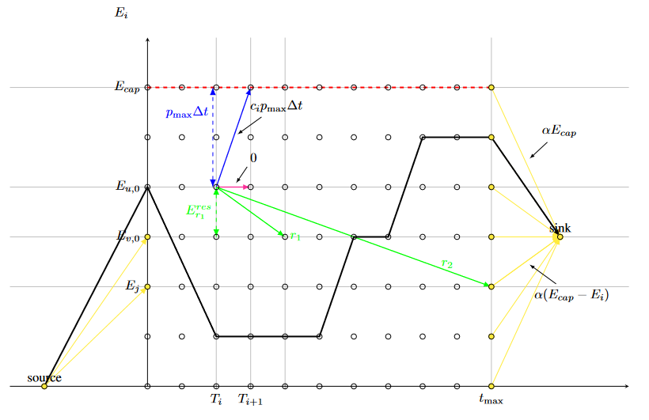
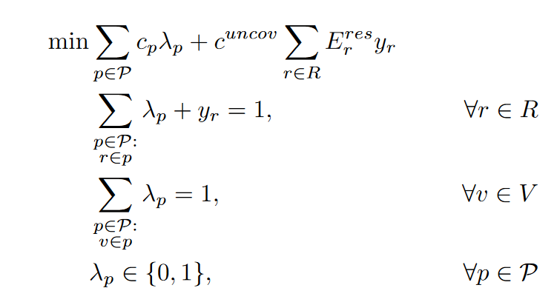
Electric Mobility Problem
Margarita Veshchezerova, Mikhail Somov, David Bertsche, Steffen Limmer, Sebastian Schmitt, Michael Perelshtein, Ayush Joshi Tripathi: “A Hybrid Quantum-Classical Approach to the Electric Mobility Problem”
Problem Statement
Suppose we have rental EVs. We use each EV to satisfy reservations.
The objective is : to satisfy all reservations while spending the least amount of energy possible.

Slide 6
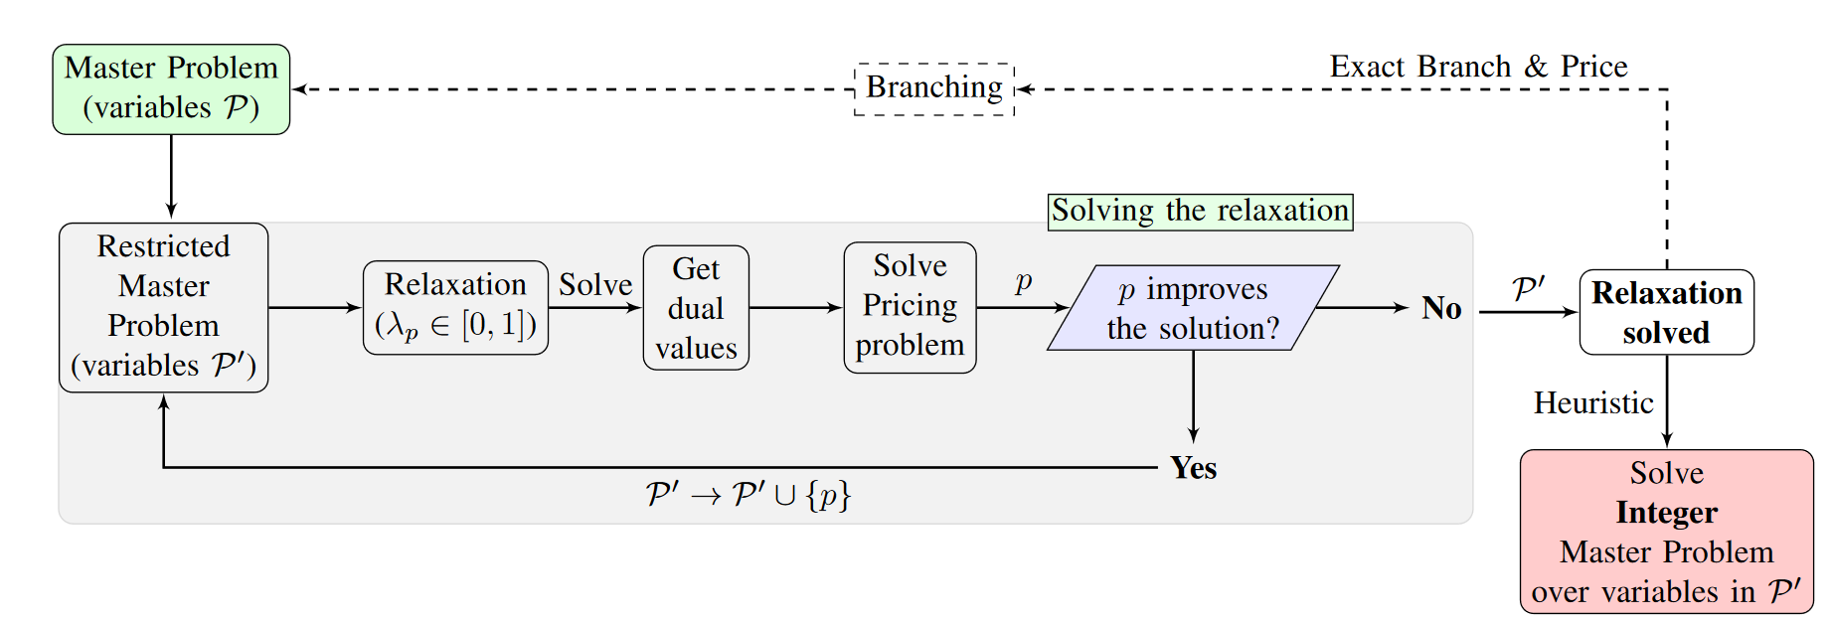
Electric Mobility Problem
Margarita Veshchezerova, Mikhail Somov, David Bertsche, Steffen Limmer, Sebastian Schmitt, Michael Perelshtein, Ayush Joshi Tripathi: “A Hybrid Quantum-Classical Approach to the Electric Mobility Problem”

Slide 7
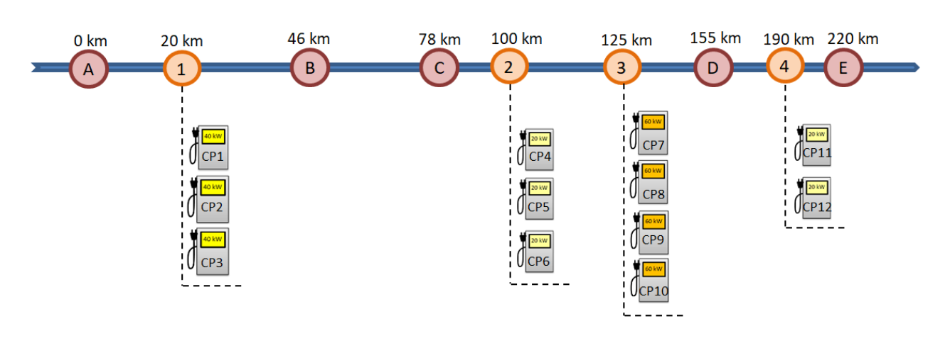
Charging Electric Cars on a Motorway
Różycki, R.; Józefowska, J.; Kurowski, K.; Lemański, T.; Pecyna, T.; Subocz, M.; Waligóra, G. A Quantum Approach to the Problem of Charging Electric Cars on a Motorway. Energies 2023, 16, 442. https://doi.org/10.3390/en16010442
Problem Statement
We have a number of EVs and a number of charging stations along a motorway. Each EV operates in a specific driving mode.
The objective is: Find all the cases (driving mode and charging station to be reached by each EV) so that there will be no conflicts at the station.

Slide 8
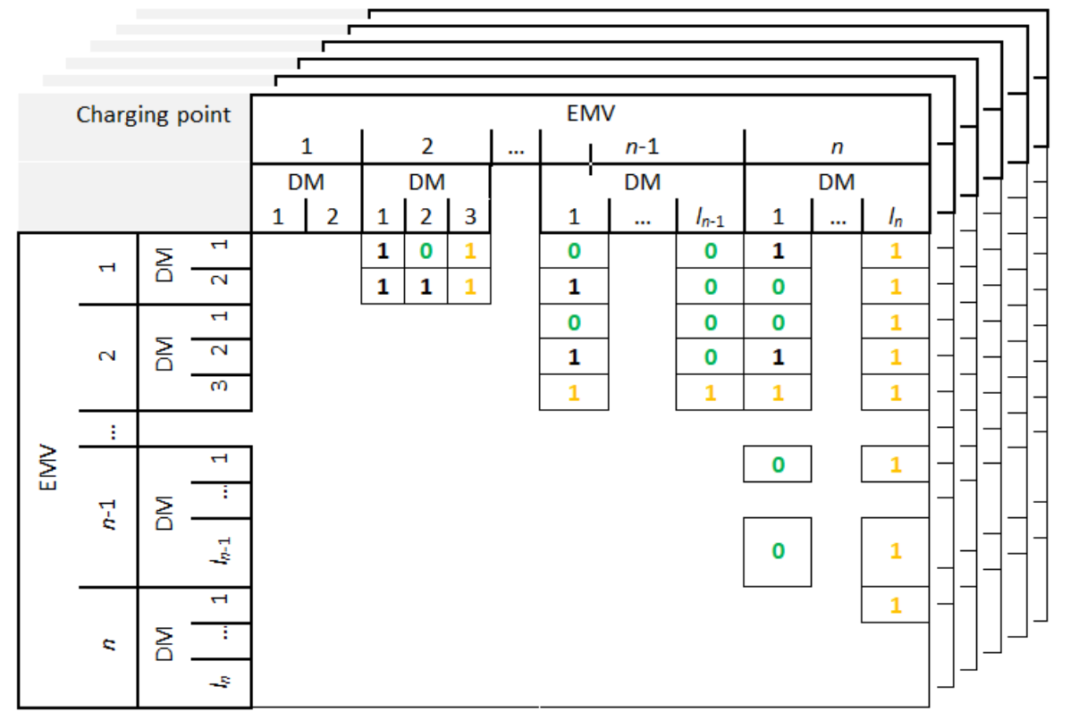
Charging Electric Cars on a Motorway
Różycki, R.; Józefowska, J.; Kurowski, K.; Lemański, T.; Pecyna, T.; Subocz, M.; Waligóra, G. A Quantum Approach to the Problem of Charging Electric Cars on a Motorway. Energies 2023, 16, 442. https://doi.org/10.3390/en16010442

Slide 9
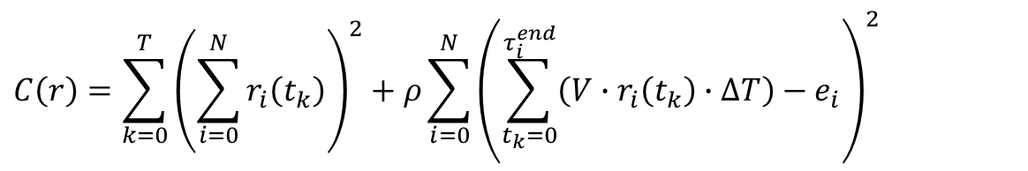
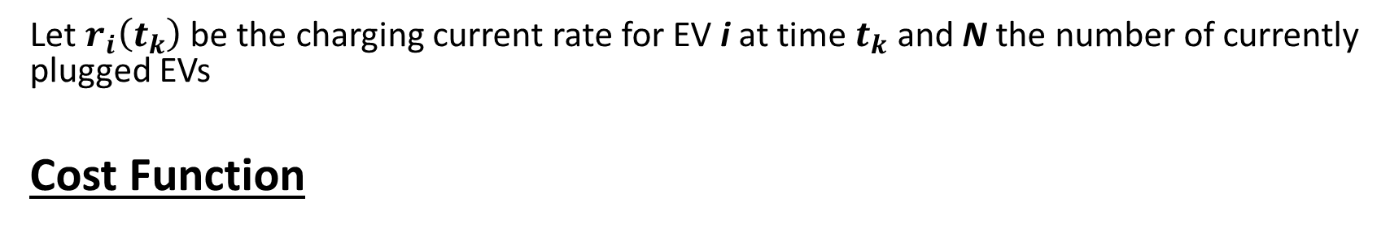
QUBO Formulation of the initial Problem
Let $r_{i}\left(t_{k}\right)$ be the charging current rate for EV i at time $t_{k}$ and N the number of currently plugged EVs
Cost Function
$$C\left(r\right)=\sum_{k=0}^{T}{{\left(\sum_{i=0}^{N}{r_{i}\left(t_{k}\right)}\right)}^{2}+ρ}\sum_{i=0}^{N}{{\left(\sum_{t_{k}=0}^{τ_{i}^{end}}{\left(V∙r_{i}\left(t_{k}\right)∙ΔT\right)}−e_{i}\right)}^{2}}$$

Slide 10
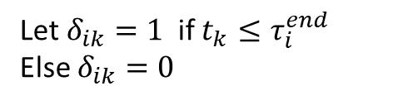
QUBO Formulation of the initial Problem
Let $r_{i}\left(t_{k}\right)$ be the charging current rate for EV i at time $t_{k}$ and N the number of currently plugged EVs
Cost Function
$$C\left(r\right)=\sum_{k=0}^{T}{{\left(\sum_{i=0}^{N}{r_{i}\left(t_{k}\right)}\right)}^{2}+ρ}\sum_{i=0}^{N}{{\left(\sum_{t_{k}=0}^{τ_{i}^{end}}{\left(V∙r_{i}\left(t_{k}\right)∙ΔT\right)}−e_{i}\right)}^{2}}$$
Let $δ_{ik}=1$if $t_{k}≤τ_{i}^{end}$
Else $δ_{ik}=0$

Slide 11
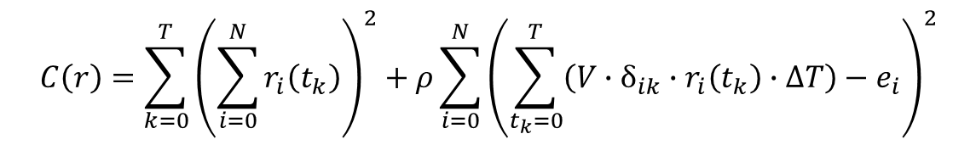
QUBO Formulation of the initial Problem
Let $r_{i}\left(t_{k}\right)$ be the charging current rate for EV i at time $t_{k}$ and N the number of currently plugged EVs
Cost Function
$$C\left(r\right)=\sum_{k=0}^{T}{{\left(\sum_{i=0}^{N}{r_{i}\left(t_{k}\right)}\right)}^{2}+ρ}\sum_{i=0}^{N}{{\left(\sum_{t_{k}=0}^{τ_{i}^{end}}{\left(V∙r_{i}\left(t_{k}\right)∙ΔT\right)}−e_{i}\right)}^{2}}$$
Let $δ_{ik}=1$if $t_{k}≤τ_{i}^{end}$
Else $δ_{ik}=0$
$$C\left(r\right)=\sum_{k=0}^{T}{{\left(\sum_{i=0}^{N}{r_{i}\left(t_{k}\right)}\right)}^{2}+ρ}\sum_{i=0}^{N}{{\left(\sum_{t_{k}=0}^{T}{\left(V∙δ_{ik}∙r_{i}\left(t_{k}\right)∙ΔT\right)}−e_{i}\right)}^{2}}$$

Slide 12
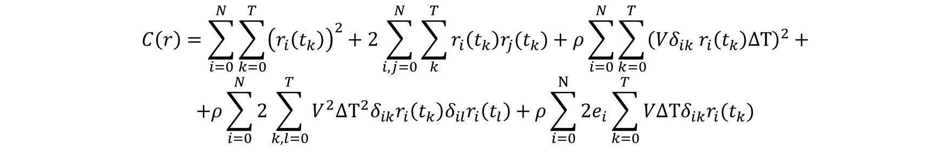
QUBO Formulation of the initial Problem
$$C\left(r\right)=\sum_{i=0}^{N}{\sum_{k=0}^{T}{{\left(r_{i}\left(t_{k}\right)\right)}^{2}}+2\sum_{i,j=0}^{N}{\sum_{k}^{T}{r_{i}\left(t_{k}\right)r_{j}(t_{k})}}+ρ}\sum_{i=0}^{N}{\sum_{k=0}^{T}{{\left(Vδ_{ik} r_{i}\left(t_{k}\right)ΔΤ\right)}^{2}}}+$$
$$+ρ\sum_{i=0}^{N}{2\sum_{k,l=0}^{T}{V^{2}ΔΤ^{2}δ_{ik}r_{i}\left(t_{k}\right)δ_{il}r_{i}\left(t_{l}\right)}+ρ\sum_{i=0}^{Ν}{{2e}_{i}\sum_{k=0}^{T}{VΔΤδ_{ik}r_{i}(t_{k})}}}$$

Slide 13

QUBO Formulation of the initial Problem
$$C\left(r\right)=\sum_{i=0}^{N}{\sum_{k=0}^{T}{{\left(r_{i}\left(t_{k}\right)\right)}^{2}}+2\sum_{i,j=0}^{N}{\sum_{k}^{T}{r_{i}\left(t_{k}\right)r_{j}(t_{k})}}+ρ}\sum_{i=0}^{N}{\sum_{k=0}^{T}{{\left(Vδ_{ik} r_{i}\left(t_{k}\right)ΔΤ\right)}^{2}}}+$$
$$+ρ\sum_{i=0}^{N}{2\sum_{k,l=0}^{T}{V^{2}ΔΤ^{2}δ_{ik}r_{i}\left(t_{k}\right)δ_{il}r_{i}\left(t_{l}\right)}+ρ\sum_{i=0}^{Ν}{{2e}_{i}\sum_{k=0}^{T}{VΔΤδ_{ik}r_{i}(t_{k})}}}$$
Convert to binary.
Simplify set of allowable current to {0,16,32,48}
$$r_{i}\left(t_{k}\right)=16 \sum_{q=0}^{1}{2^{q}x_{ikq}}$$

Slide 14
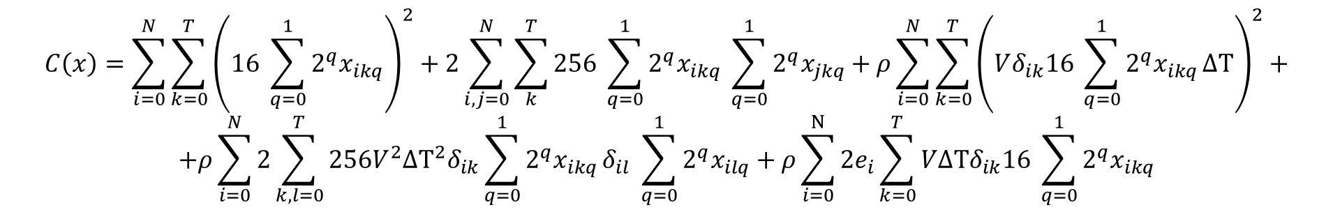
QUBO Formulation of the initial Problem
$$C\left(r\right)=\sum_{i=0}^{N}{\sum_{k=0}^{T}{{\left(r_{i}\left(t_{k}\right)\right)}^{2}}+2\sum_{i,j=0}^{N}{\sum_{k}^{T}{r_{i}\left(t_{k}\right)r_{j}(t_{k})}}+ρ}\sum_{i=0}^{N}{\sum_{k=0}^{T}{{\left(Vδ_{ik} r_{i}\left(t_{k}\right)ΔΤ\right)}^{2}}}+$$
$$+ρ\sum_{i=0}^{N}{2\sum_{k,l=0}^{T}{V^{2}ΔΤ^{2}δ_{ik}r_{i}\left(t_{k}\right)δ_{il}r_{i}\left(t_{l}\right)}+ρ\sum_{i=0}^{Ν}{{2e}_{i}\sum_{k=0}^{T}{VΔΤδ_{ik}r_{i}(t_{k})}}}$$
Convert to binary.
Simplify set of allowable current to {0,16,32,48}
$$r_{i}\left(t_{k}\right)=16 \sum_{q=0}^{1}{2^{q}x_{ikq}}$$
$$C\left(x\right)=\sum_{i=0}^{N}{\sum_{k=0}^{T}{{\left(16 \sum_{q=0}^{1}{2^{q}x_{ikq}}\right)}^{2}}+2\sum_{i,j=0}^{N}{\sum_{k}^{T}{256 \sum_{q=0}^{1}{2^{q}x_{ikq}} \sum_{q=0}^{1}{2^{q}x_{jkq}}}}+ρ}\sum_{i=0}^{N}{\sum_{k=0}^{T}{{\left(Vδ_{ik}16 \sum_{q=0}^{1}{2^{q}x_{ikq}}ΔΤ\right)}^{2}}}+$$
$$+ρ\sum_{i=0}^{N}{2\sum_{k,l=0}^{T}{{256V}^{2}ΔΤ^{2}δ_{ik}\sum_{q=0}^{1}{2^{q}x_{ikq}}δ_{il} \sum_{q=0}^{1}{2^{q}x_{ilq}}}+ρ\sum_{i=0}^{Ν}{{2e}_{i}\sum_{k=0}^{T}{VΔΤδ_{ik}16 \sum_{q=0}^{1}{2^{q}x_{ikq}}}}}$$

Slide 15
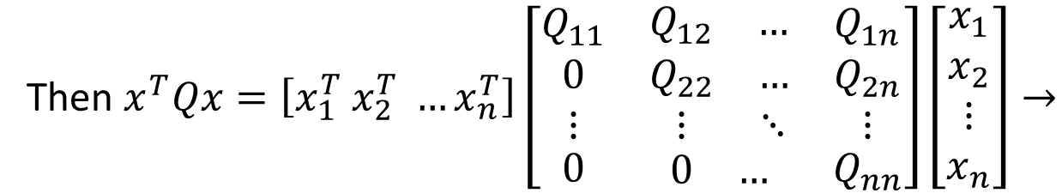
ClusterVQE
Split vector $x$ to n clusters of equal length $x_{1},x_{2},…,x_{n}$
Then $x^{T}Qx=\left[x_{1}^{T} x_{2}^{T} …x_{n}^{T}\right]\left[\begin{matrix}Q_{11} & \begin{matrix}Q_{12} & …\end{matrix} & Q_{1n} \\ \begin{matrix}0 \\ ⋮\end{matrix} & \begin{matrix}Q_{22} & … \\ ⋮ & ⋱\end{matrix} & \begin{matrix}Q_{2n} \\ ⋮\end{matrix} \\ 0 & \begin{matrix}0 & …\end{matrix} & Q_{nn}\end{matrix}\right]\left[\begin{aligned}x_{1} \\ x_{2} \\ ⋮ \\ x_{n}\end{aligned}\right]→$

Slide 16
ClusterVQE
Split vector $x$ to n clusters of equal length $x_{1},x_{2},…,x_{n}$
Then $x^{T}Qx=\left[x_{1}^{T} x_{2}^{T} …x_{n}^{T}\right]\left[\begin{matrix}Q_{11} & \begin{matrix}Q_{12} & …\end{matrix} & Q_{1n} \\ \begin{matrix}0 \\ ⋮\end{matrix} & \begin{matrix}Q_{22} & … \\ ⋮ & ⋱\end{matrix} & \begin{matrix}Q_{2n} \\ ⋮\end{matrix} \\ 0 & \begin{matrix}0 & …\end{matrix} & Q_{nn}\end{matrix}\right]\left[\begin{aligned}x_{1} \\ x_{2} \\ ⋮ \\ x_{n}\end{aligned}\right]→$
$x^{T}Qx=x_{1}^{T}Q_{11}x_{1}+x_{2}^{T}Q_{22}x_{2}^{}+…+x_{n}^{T}Q_{nn}x_{n}+$ $x_{1}^{T}Q_{12}x_{2}+…+x_{1}^{T}Q_{1n}x_{n}+…+x_{2}^{T}Q_{2n}x_{n}+…$

Slide 17
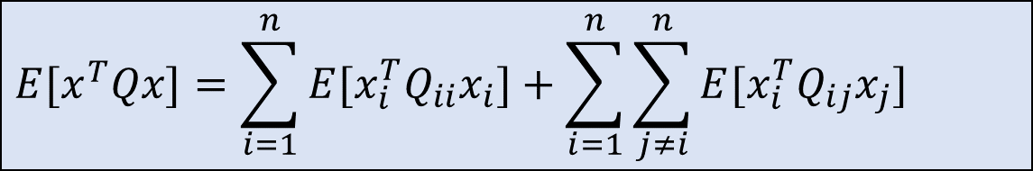
ClusterVQE
Split vector $x$ to n clusters of equal length $x_{1},x_{2},…,x_{n}$
Then $x^{T}Qx=\left[x_{1}^{T} x_{2}^{T} …x_{n}^{T}\right]\left[\begin{matrix}Q_{11} & \begin{matrix}Q_{12} & …\end{matrix} & Q_{1n} \\ \begin{matrix}0 \\ ⋮\end{matrix} & \begin{matrix}Q_{22} & … \\ ⋮ & ⋱\end{matrix} & \begin{matrix}Q_{2n} \\ ⋮\end{matrix} \\ 0 & \begin{matrix}0 & …\end{matrix} & Q_{nn}\end{matrix}\right]\left[\begin{aligned}x_{1} \\ x_{2} \\ ⋮ \\ x_{n}\end{aligned}\right]→$
$x^{T}Qx=x_{1}^{T}Q_{11}x_{1}+x_{2}^{T}Q_{22}x_{2}^{}+…+x_{n}^{T}Q_{nn}x_{n}+$ $x_{1}^{T}Q_{12}x_{2}+…+x_{1}^{T}Q_{1n}x_{n}+…+x_{2}^{T}Q_{2n}x_{n}+…$
${E[x}^{T}Qx]=E[x_{1}^{T}Q_{11}x_{1}]+E[x_{2}^{T}Q_{22}x_{2}^{T}]+…+E[x_{n}^{T}Q_{nn}x_{n}]+E[$ $x_{1}^{T}Q_{12}x_{2}]+…+E[x_{1}^{T}Q_{1n}x_{n}]+…+E[x_{2}^{T}Q_{2n}x_{n}]+…$
$${E[x}^{T}Qx]=\sum_{i=1}^{n}{{E[x}_{i}^{T}Q_{ii}x_{i}]}+\sum_{i=1}^{n}{\sum_{j≠i}^{n}{{E[x}_{i}^{T}Q_{ij}x_{j}]}}$$

Slide 18


VQE
HEA
$$θ$$
$$x→ E[x^{T}Qx]$$

Slide 19








VQE
HEA
$$θ$$
$$x→ E[x^{T}Qx]$$
HEA
ClusterVQE
$$θ_{1}$$
$$x_{1}→ E[x_{1}^{T}Q_{11}x_{1}]$$
HEA
$$θ_{2}$$
$$x_{2}→ E[x_{2}^{T}Q_{22}x_{1}]$$
$$E\left[x^{T}Qx\right]= …$$
$$⋮$$
HEA
$$θ_{n}$$
$$x_{n}→ E[x_{n}^{T}Q_{nn}x_{n}]$$

Slide 20

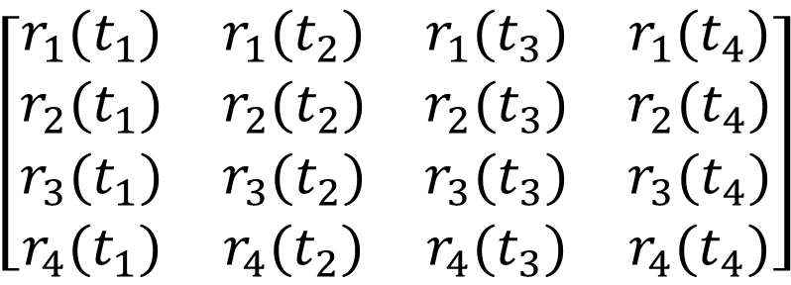

Apply ClusterVQE to EV charging problem
$$Horizon$$
$$\left[\begin{matrix}\begin{matrix}r_{1}(t_{1}) & r_{1}(t_{2}) \\ r_{2}(t_{1}) & r_{2}(t_{2})\end{matrix} & \begin{matrix}r_{1}(t_{3}) & r_{1}(t_{4}) \\ r_{2}(t_{3}) & r_{2}(t_{4})\end{matrix} \\ \begin{matrix}r_{3}(t_{1}) & r_{3}(t_{2}) \\ r_{4}(t_{1}) & r_{4}(t_{2})\end{matrix} & \begin{matrix}r_{3}(t_{3}) & r_{3}(t_{4}) \\ r_{4}(t_{3}) & r_{4}(t_{4})\end{matrix}\end{matrix}\right]$$
$$r_{2}$$
Num of EVs = N
Advantages of ClusterVQE
Reduce the number of qubits by a factor of N
Increase the number of measurements by a factor of N
*Can also be used with qubit compression

Slide 21
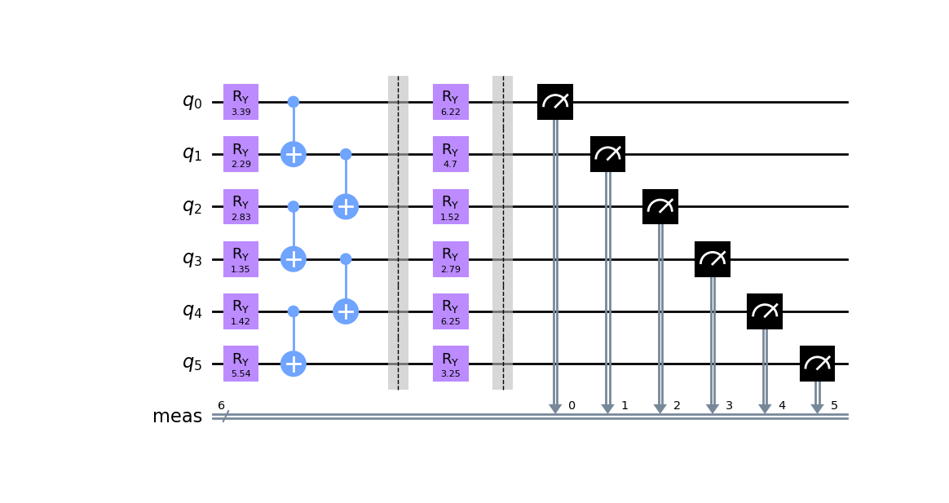
Circuit: HEA with 2 layers

Slide 22
Comparison
For an example with T=4 hours , Evs = 4 and 2 layer HEA
Algorithm | #Classical Variables | #Qubits | #Shots | #parameters θ | #Ry gates | #CNOT gates | #gates | #iterations
VQE | 16 | 32 | 5000 | 64 | 64 | 31 | 95 | 400+
CompressedVQE | 16 | 6 | 100000 | 12 | 12 | 5 | 17 | 130
ClusterVQE | 16 | 8 | 40000 | 64 | 16 | 7 | 23 | -
ClusterCompressedVQE | 16 | 4 | 40000 | 32 | 8 | 3 | 11 | -

Slide 23
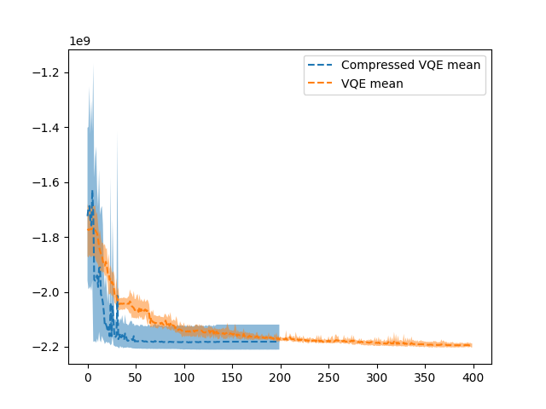
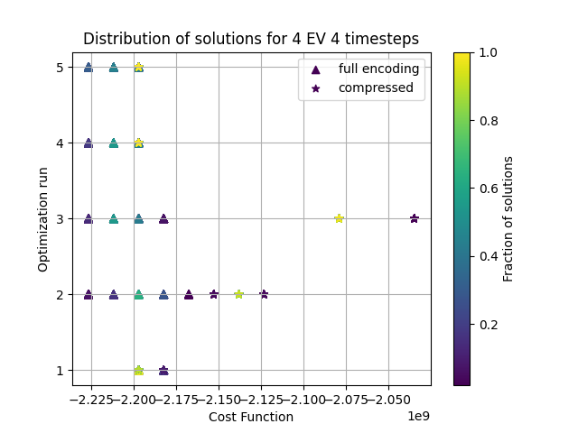
Comparison

Slide 24
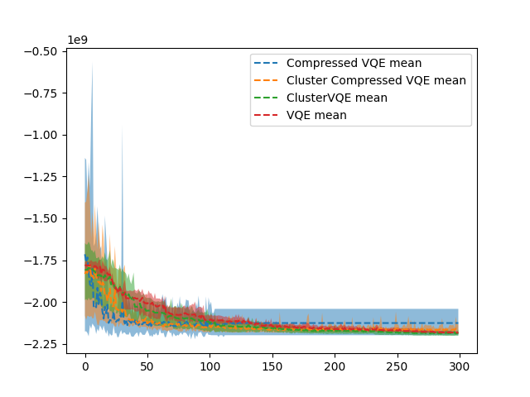
Comparison

Slide 25
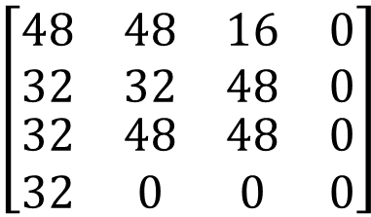
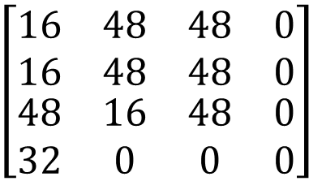
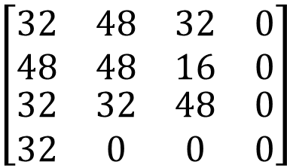
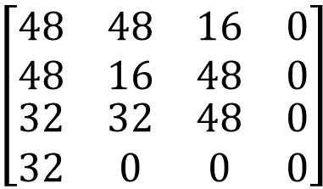
Comparison
CompressedVQE
ClusterCompressedVQE
$$\left[\begin{matrix}\begin{matrix}16 & 48 \\ 16 & 48\end{matrix} & \begin{matrix}48 & 0 \\ 48 & 0\end{matrix} \\ \begin{matrix}48 & 16 \\ 32 & 0\end{matrix} & \begin{matrix}48 & 0 \\ 0 & 0\end{matrix}\end{matrix}\right]$$
26880/26880
26880/26880
26880/26880
7680/7680
$$\left[\begin{matrix}\begin{matrix}48 & 48 \\ 32 & 32\end{matrix} & \begin{matrix}16 & 0 \\ 48 & 0\end{matrix} \\ \begin{matrix}32 & 48 \\ 32 & 0\end{matrix} & \begin{matrix}48 & 0 \\ 0 & 0\end{matrix}\end{matrix}\right]$$
26880/26880
26880/26880
32720/26880
7680/7680
ClusterVQE
VQE
$$\left[\begin{matrix}\begin{matrix}48 & 48 \\ 48 & 16\end{matrix} & \begin{matrix}16 & 0 \\ 48 & 0\end{matrix} \\ \begin{matrix}32 & 32 \\ 32 & 0\end{matrix} & \begin{matrix}48 & 0 \\ 0 & 0\end{matrix}\end{matrix}\right]$$
26880/26880
26880/26880
26880/26880
7680/7680
$$\left[\begin{matrix}\begin{matrix}32 & 48 \\ 48 & 48\end{matrix} & \begin{matrix}32 & 0 \\ 16 & 0\end{matrix} \\ \begin{matrix}32 & 32 \\ 32 & 0\end{matrix} & \begin{matrix}48 & 0 \\ 0 & 0\end{matrix}\end{matrix}\right]$$
26880/26880
26880/26880
26880/26880
7680/7680

Slide 26
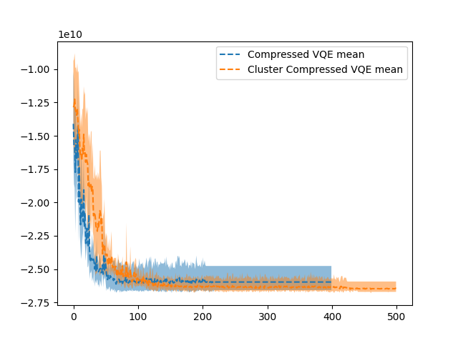
Comparison:64 EVs, 12 time step Horizon

